Slide 1
Wired LAN Technology (Ethernet and 802.3)

Slide 2
Ethernet (IEEE 802.3)
Widely used LAN technology
Invented at Xerox PARC (Palo Alto Research Center) in 1970s
Defined in a standard by Xerox, Intel and Digital - DIX standard
Standard now managed by IEEE - defines formats, voltages, cable lengths, ...
Uses bus topology
Single coax cable - the ether
Multiple computers connect
One Ethernet cable is sometimes called a segment
Limited to 500 meters in length (for 10base5)
100 meters for Gigabit Ethernet and fast ethernet(over copper)
Minimum separation between connections is 3 meters

Slide 3
Ethernet Frame Format
header
46 – 1500 bytes of payload
4-byte CRC
6 byte destination
address
6 byte source
address
2 byte type

Slide 4
Ethernet Type Field and Demultiplexing
The type field in an Ethernet frame
provides multiplexing and demultiplexing
Allows multiple protocols operating simultaneously
IP datagrams and ARP messages over Ethernet
hexadecimal 0800 for IP datagrams
hexadecimal 0806 for ARP messages
When transmitting a datagram in an Ethernet frame, the sender assigns a type 0800
Upon arrival at its destination
examines the type field, and determine which software module should process the frame

Slide 5
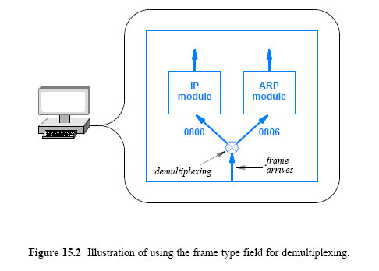

Slide 6
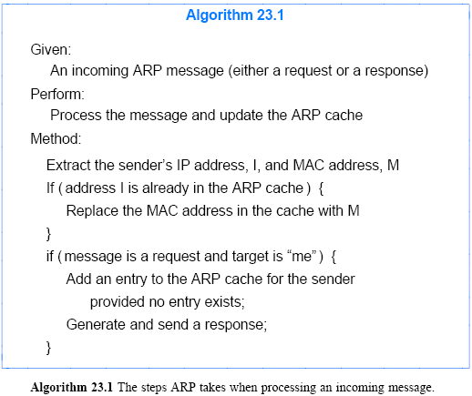

Address Resolution Protocol (ARP)
ARP! ARP!

Slide 7
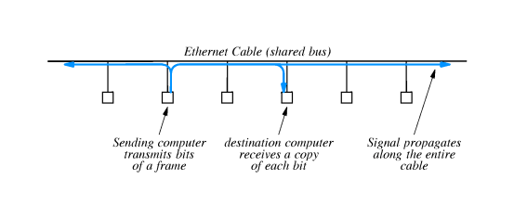
Ethernet operation
One computer transmits at a time
Signal is a modulated carrier which propagates from transmitter in both directions along length of segment

Slide 8
IEEE's Version of Ethernet (802.3)
IEEE developed a standard for Ethernet (1983) and attempted to redefine the Ethernet frame format
IEEE 802.3 Ethernet
The major difference is on the interpretation of the type field
The 802.3 standard:
interprets “type” field as a packet length
8-byte extra header is added
The extra header
Logical Link Control / Sub-Network Attachment Point (LLC/SNAP) header or simply SNAP header

Slide 9
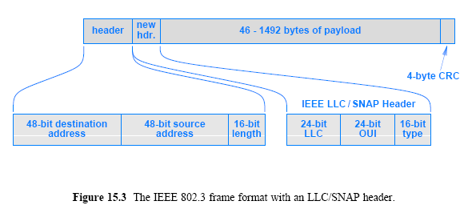
IEEE's Version of Ethernet (802.3)

Slide 10
IEEE's Version of Ethernet (802.3) cont’
The frame size in 802.3 Ethernet:
1514 bytes
the same as conventional Ethernet:
the maximum payload from 1500 bytes to 1492 bytes
SNAP header occupies the first 8 bytes of the payload
To keep the two versions of Ethernet compatible, a convention is used:
If bytes 13-14 of a frame contain a numeric value less than 1500
the field is interpreted as a packet length and the 802.3 standard applies
otherwise, the field is interpreted as a type field

Slide 11
LAN connections and NICs
A NIC handles
address recognition
CRC computation
frame recognition
sending/receiving frames
A NIC consists of a circuit board with separate processor
The NIC is independent from the rest of the computer
Generally not replaceable (built-in)
Independent processing

Slide 12
Twisted Pair Ethernet Wiring and Hubs
A third generation:
Uses a central electronic device separate from the computers attached to the network
Uses twisted pair wiring
Informally known as twisted pair Ethernet
In general Ethernet means twisted pair Ethernet
The electronic device known as a hub
Various size of hubs available, but recently replaced with switches

Slide 13
Twisted Pair Ethernet Wiring And Hubs
Twisted pair wiring
Computer
With NIC
Computer
With NIC
Computer
With NIC
hub

Slide 14
Twisted Pair Ethernet Wiring And Hubs
A hub emulates a physical cable
making the entire system operate like a conventional Ethernet
A system that uses a hub in CSMA/CD
receives a copy of each frame
uses the address to determine
whether to process or ignore the frame
Twisted pair Ethernet retains the same frame format as the previous versions
Software on a computer cannot distinguish between thick Ethernet, thin Ethernet, and twisted pair Ethernet
The NIC handles the details and hides any differences

Slide 15
Physical and Logical Ethernet Topology
Twisted pair Ethernet
Physically follows a star topology
Hub emulates physical cable
Logically “ bus in a box”

Slide 16
Wiring in an Office Building
The type of wiring makes a major difference in terms of
the type
number of wires needed
the distance spanned
the cost
The three versions of Ethernet wiring illustrate the three principal forms that LANs use
Figure 15.7 depicts wiring on a floor of an office building
Twisted pair Ethernet requires many individual cables to go between offices and a central point (wiring closet)
Thus, twisted pair Ethernet requires careful labeling of cables

Slide 17
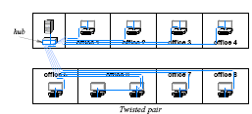
Figure 15.7 Illustration of various LAN wiring schemes that have been used in an office building (Part II)

Slide 18
Variants of Twisted Pair Ethernet and Speeds
Higher-speed Ethernet technologies use an electronic device known as a switch rather than a hub
To remain backward compatible
standards for the higher-speed versions specify how to determine speed automatically
slow down, if necessary, to accommodate older devices
For example, if an old device uses 10BaseT and a new device uses 1000BaseT, the new device will autosense

Slide 19
Variants of Twisted Pair Ethernet
Category | Max. Data Rate | Bandwidth | Max. Distance | Usage
Category 1 | 1 Mbps | 0.4 MHz |  | Telephone and modem lines
Category 2 | 4 Mbps | 4 MHz |  | LocalTalk & Telephone
Category 3 | 10 Mbps | 16 MHz | 100 m (328 ft.) | 10BaseT Ethernet
Category 4 | 16 Mbps | 20 MHz | 100 m (328 ft.) | Token Ring
Category 5 | 100 Mbps | 100 MHz | 100 m (328 ft.) | 100BaseT Ethernet
Category 5e | 1 Gbps | 100 MHz | 100 m (328 ft.) | 100BaseT Ethernet, residential homes
Category 6 | 1 Gbps | 250 MHz | 100 m (328 ft.) 10Gb at 37 m (121 ft.) | Gigabit Ethernet, commercial buildings
Category 6a | 10 Gbps | 500 MHz | 100 m (328 ft.) | Gigabit Ethernet in data centers and commercial buildings
Category 7 | 10 Gbps | 600 MHz | 100 m (328 ft.) | 10 Gbps Core Infrastructure
Category 7a | 10 Gbps | 1000 MHz | 100 m (328 ft.) 40Gb at 50 m (164 ft.) | 10 Gbps Core Infrastructure
Category 8 | 25 Gbps (Cat8.1) 40 Gbps (Cat8.2) | 2000 MHz | 30 m (98 ft.) | 25 Gbps/40 Gbps Core Infrastructure

Slide 20
Twisted Pair Connectors and Cables
Twisted pair Ethernet uses RJ45 connectors
Telephones use RJ11 connectors
Two different cabling:
A straight cable
used between a computer and a switch
connects each pin of the RJ45 directly to the corresponding pin on the RJ45 at the other end
A crossed cable
Used to connect two switches
Connects each pin on one end to a different pin on the other end in reverse order
To help technicians make the correct connections
individual wires in a Category 5 or Category 6 cable are coated with colored plastic
Figure 15.9 lists the color codes used with a straight cable

Slide 21
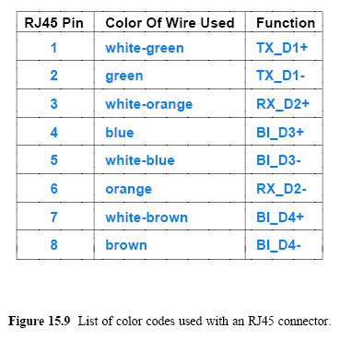
Twisted Pair Connectors and Cables

